Slide 1

Overview
Climate change - basics
  Terminology / glossaries
  The Earth‘s climate system – key features
  Causes of a changing climate – emmisions
  Impacts
Taking action
  Mitigation
  Adaptation

Slide 2



Slide 3
Key Documents
IPCC Assessment Reports:
  The Physical Science Basis
  ..\hyperlink-material\ar5-spm-physical-science.pdf
  Impacts, Adaptation and Vulnerability
  ..\hyperlink-material\ar5-spm-adaptation.pdf
  Mitigation
  ..\hyperlink-material\ar5-spm-mitigation.pdf
Millennium Ecosystem Assessment
http://www.millenniumassessment.org/en/index.html

Slide 4
Glossaries in Key Documents
Climate Change 2014: Impacts, Adaptation and Vulnerability, Glossary:
..\hyperlink-material\ar5-glossary-adaptation.pdf
Climate Change 2014: Mitigation of Climate Change, Glossary:
..\hyperlink-material\ar5-glossary-mitigation.pdf
Climate Change 2013: The Physical Science Basis, Glossary:
..\hyperlink-material\ar5-glossary-physical-science-basis.pdf

Slide 5
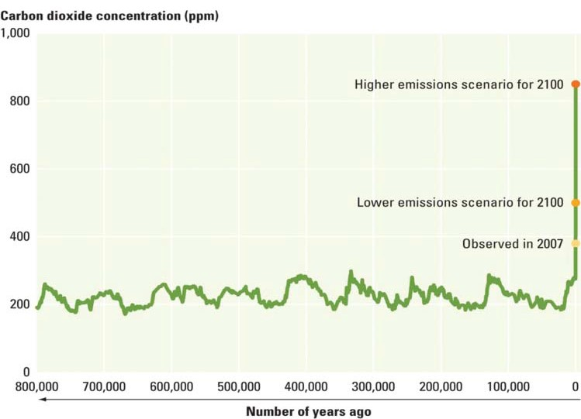
Source: World development Report 2010

Slide 6
Getting the Climate Change Measurements ?
1 Ton = 1000 kilo = 10⁶ gram
1 Kiloton = 1000 tons = 10⁹ gram
1 Megaton = 1000 X 1000 tons = 10¹² gram
1 Gigaton = 1000 megatons = 1 petagram (10¹⁵ gram)

Slide 7
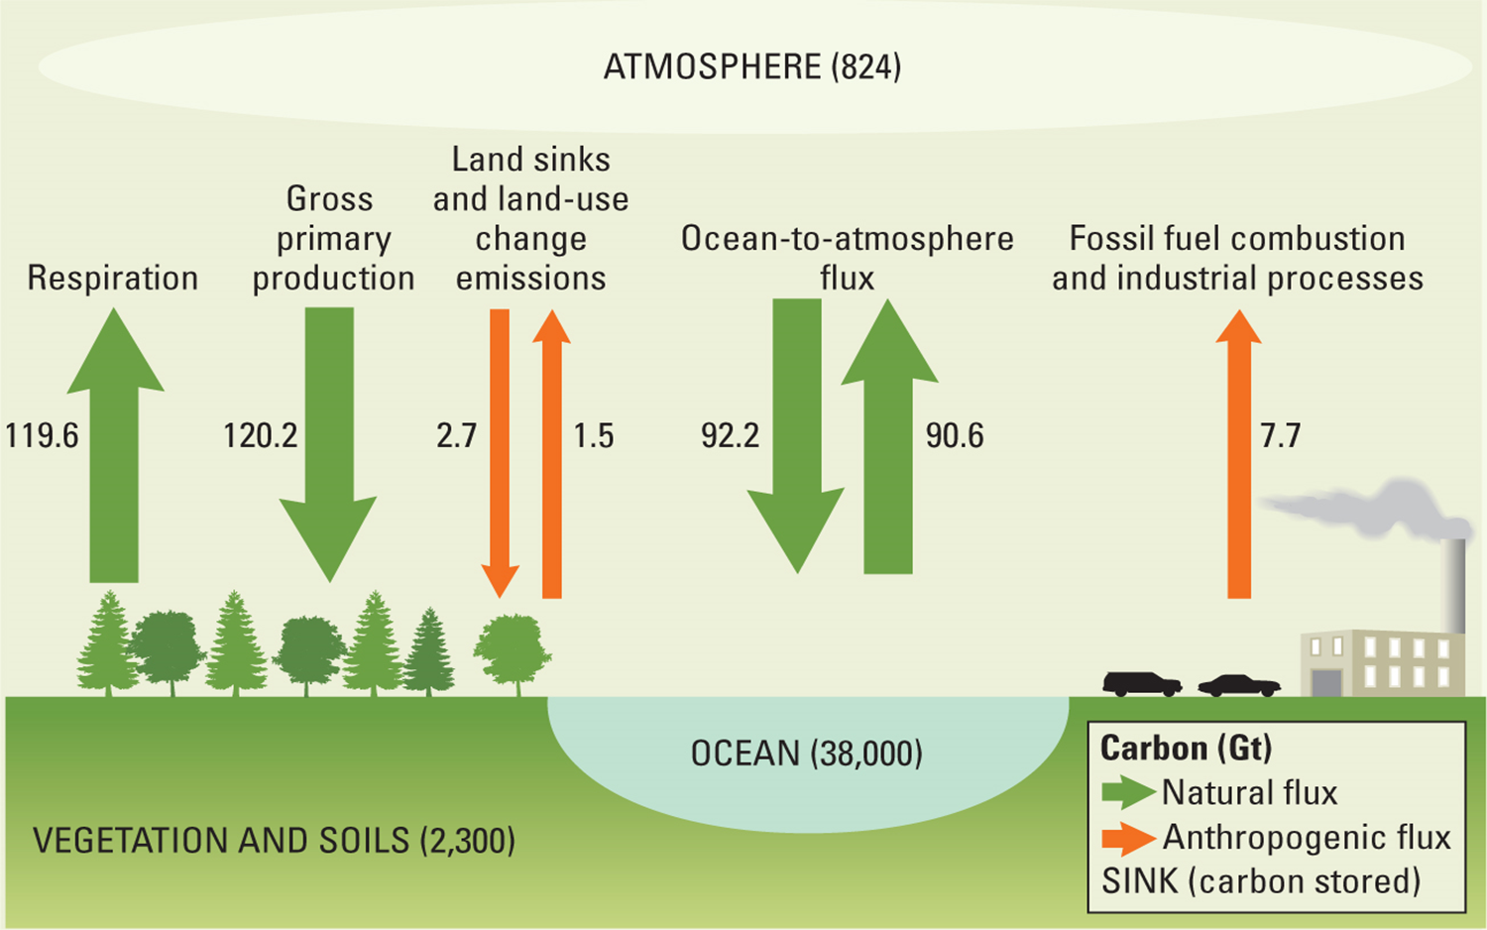
The global carbon cycle

Slide 8
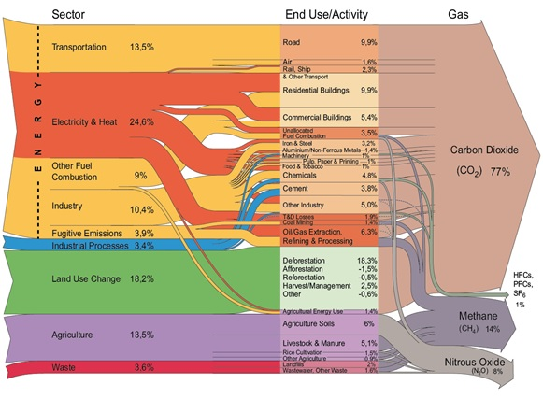
Emission sources
  Source: http://maps.grida.no/go/graphic/world-greenhouse-gas-emissions-by-sector1

Slide 9
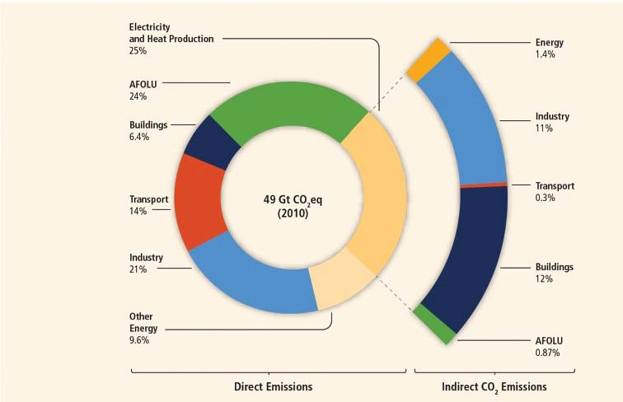
Total anthropogenic GHG emissions by economic sector
Tackling Climate Change - Bangkok, October 2015
Source: IPCC Climate Change 2013. The Physical Science Basis

Slide 10
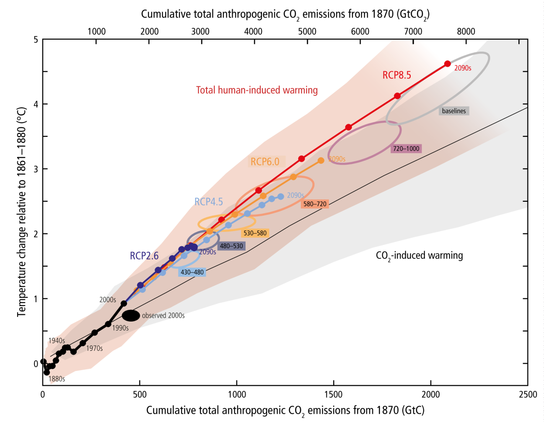
Emissions vs. Temperatures
Source: IPCC Climate Change 2013. The Physical Science Basis

Slide 11
From signals to tangible effects
  Climate Signals
  change in temperature patterns
  change in precipitation patterns
  increase in extreme weather events (storms, heat waves...)
  melting of pole caps, glaciers and permafrost
  sea-level rise
  ocean acidification
  …
  Effects
  droughts
  change of natural systems’ productivity
  increase in forest fires
  exceptional floods
  loss of land
  health issues
  ...
  Impact
  food insecurity
  loss of income
  …
  vulnerable livelihoods
  economic damages

Slide 12
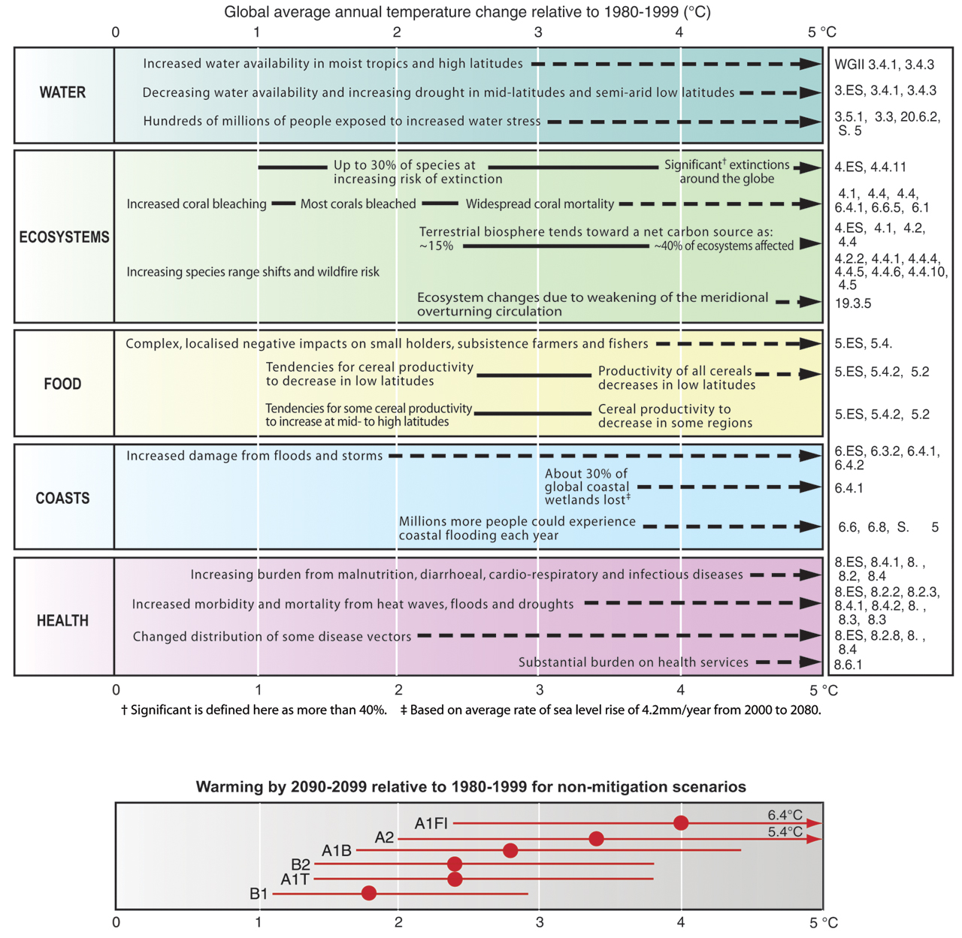
Tangible effects -II
1.5 °C
Source: Climate Change 2007. Synthesis report 2007. IPCC. Geneva

Slide 13
Tangible effects -III
See also:
IPCC 5. Assessment Report ‘Impact, Adaptation and Vulnerability’, p. 22 ff

Slide 14
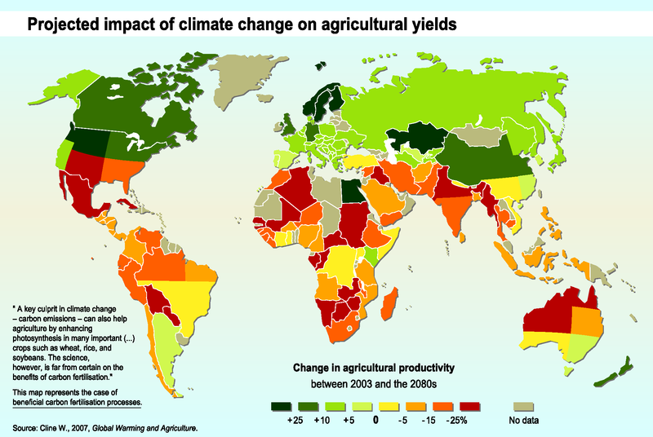
Effects on agricultural yields

Slide 15
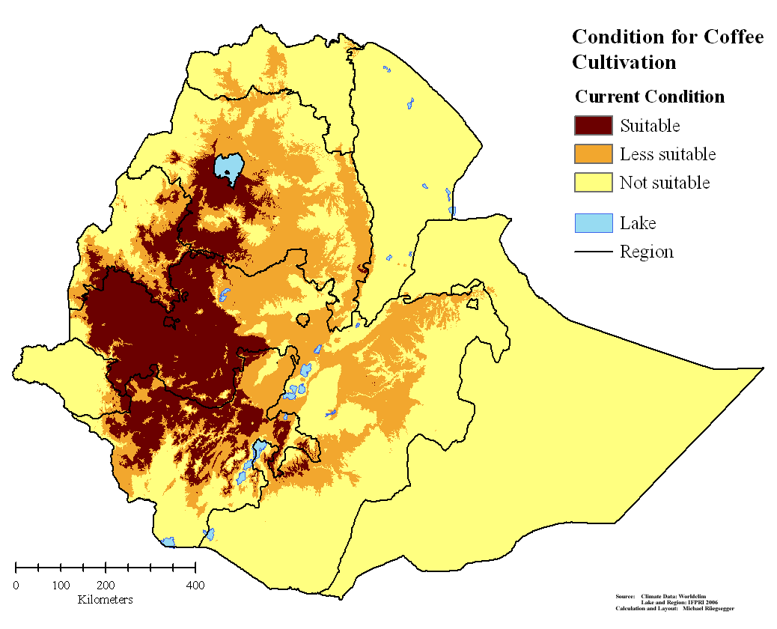
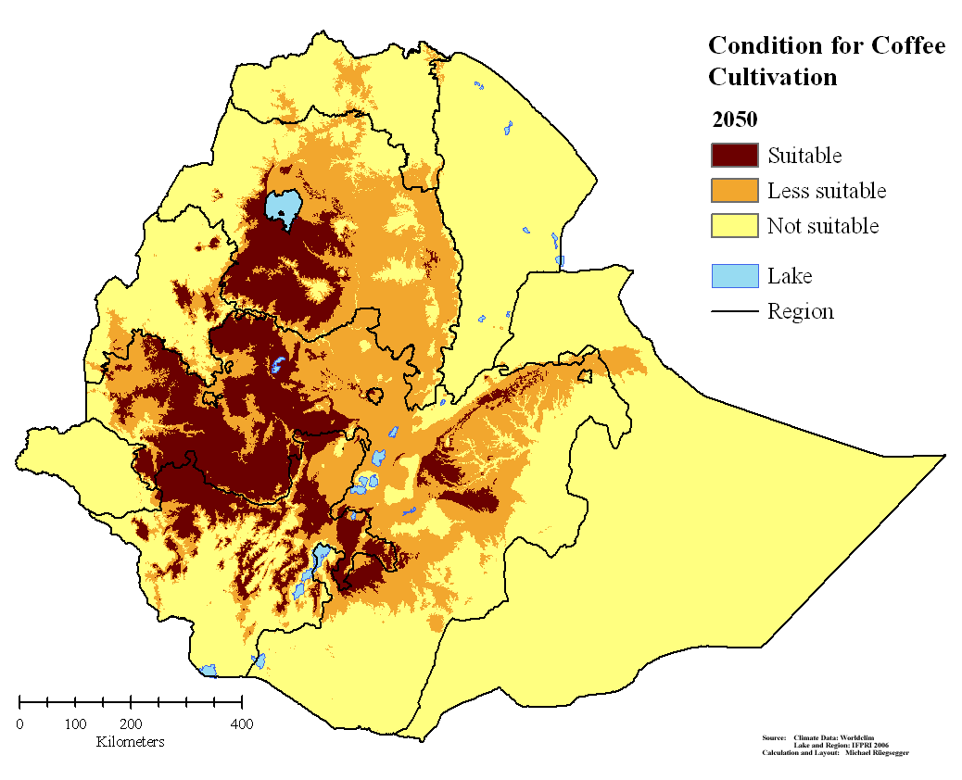
Example: Coffee Cultivation area in Ethiopia
Current conditions (1950-2000)‏
Prediction for 2050 under climate change
Rueegsegger 2008
Notes:
Trainer:
Show the slide and allow for time to realise and reflect
Comments:
Explain that Ethiopia is one of the traditional coffee growing area in the world
A large number of people depend on the coffee cultivation
The slide has two overlapping pictures
If you press the key, another slide will be visible that shows the shift of the coffee area due to changing climate patterns
Start with the slide that has the subtitle ‘CURRENT CONDITIONS (1950-2000)
Then press the key for shifting the slide and that picture shows the changes in the coffee sector as predicted due to climatic changes for 2050
Meaning: the total area suitable for coffee will reduce in size and the area will shift geographically
This causes considerable cost in terms of restructuring but offers also other opportunities

Slide 16
How certain are we?
What is – and will (partly) remain - uncertain:
Basis of understanding
  Models are representations of the Earth’s system, not portrait pictures
  Limited data availability, esp. at regional/local scale
  Limited data quality, esp. at regional/local scale
  Confidence levels of projections – inherent uncertainty
Development of GHG emissions
  Depends on decisions today
Level of adaptation and vulnerability
  Influenced by the socio-economic and ecological state AND Climate trends

Slide 17
Adaptation - Manage the un-avoidable
Adaptation (IPCC, 2013) The process of adjustment to actual or expected climate and its effects. In human systems, adaptation seeks to moderate or avoid harm or exploit beneficial opportunities. In some natural systems, human intervention may facilitate adjustment to expected climate and its effects.
  Incremental adaptation: Adaptation actions where the central aim is to maintain the essence and integrity of a system or process at a given scale.
  Transformational adaptation: Adaptation that changes the fundamental attributes of a system in response to climate and its effects.
See also: Autonomous adaptation, Evolutionary adaptation, and Transformation
Tackling Climate Change - Bangkok, October 2015

Slide 18
Mitigation - avoid the un-manageable
Mitigation of climate change: (IPCC, 2013): A human intervention to reduce the sources or enhance the sinks of greenhouse gases (GHGs)
Tackling Climate Change - Bangkok, October 2015

Slide 19
Focus Point: Adaptation Gap
Source: Denkschrift ‘Energie’. 2007. Swiss Academies of Sciences, http://www.satw.ch/publikationen/schriften/Denk-Schrift

Slide 20
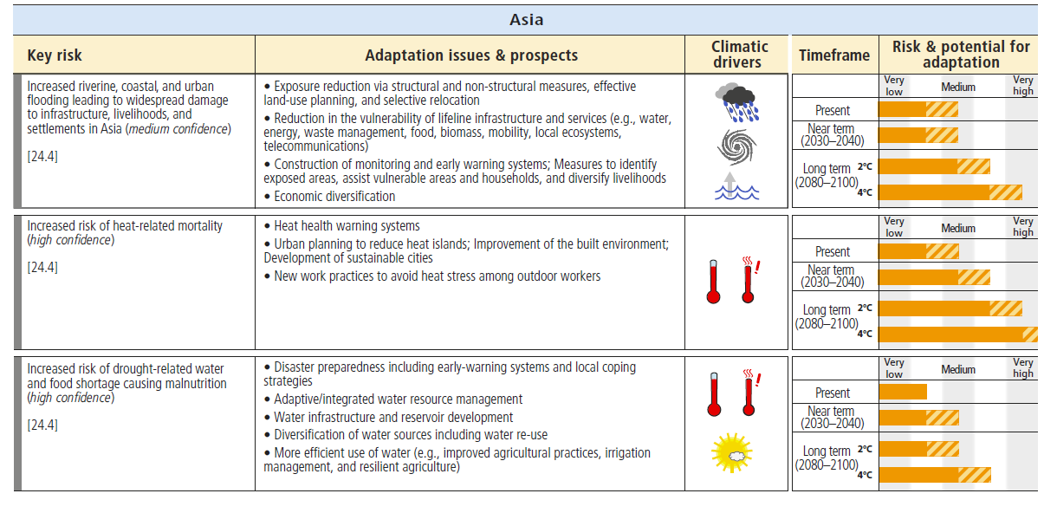
Thinking concretely about ADAPTATION
IPCC 5. Assessment Report ‘Impact, Adaptation and Vulnerability’, p. 22 ff

